Slide 1
EAHCP
EAHCP Supporting Measures
SCIENCE COMMITTEE IMPLEMENTATION MEETING
Meeting date · Location · Presenter

Slide 2
NEXT STEPS
Supporting Measures
MONITORING
RESEARCH
REFUGIA
Biological and Water Quality Monitoring
Applied Research
Edwards Aquifer Refugia Program
San Marcos salamander monitoring protocol
CSRB genetics across droughts
Comal Springs dryopid monitoring protocol
Data Management
LOOKING FORWARD
11

Slide 3
HOW TO USE THIS DECK
Template design system
Keep this slide as a reference, then remove it from the final briefing.
PALETTE
TYPE
Aptos Display
Scientific headings
AQUIFER
SPRING
FLOW
CYPRESS
LIMESTONE
ALERT
#0B3C5D
#2D7F83
#6DB6C4
#5F7D68
#D5CFC2
#C65D4A
Aptos supports compact technical prose, tables, captions, and annotation.
SLIDE RULE
FIGURE RULE
One scientific message per slide.
Direct attention with one accent.
Use the headline to state the finding—not merely name the topic.
Most data stay aquifer blue or gray; coral marks thresholds, exceptions, or decisions.
TEMPLATE GUIDANCE
02

Slide 4
01
Springflow
Protection
Section subtitle or implementation question
Use section dividers to reset the room and establish the question the next slides will answer.
SECTION DIVIDER
03

Slide 5
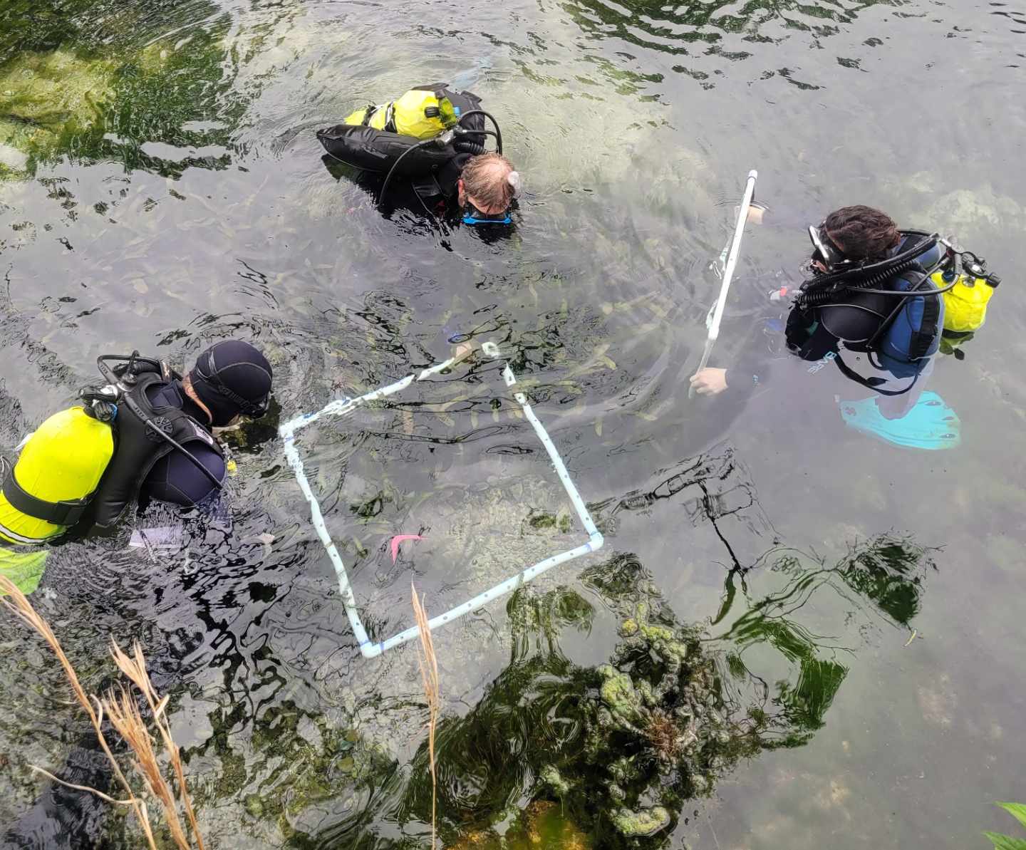
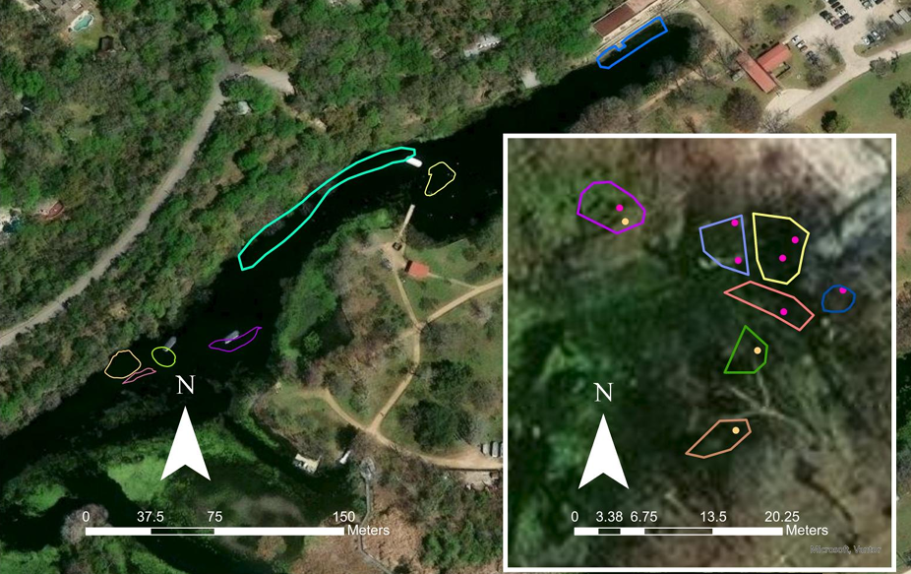
San Marcos salamander monitoring protocol
Goal: Develop sampling and analytical protocols to monitor occupancy and abundance dynamics of the San Marcos salamander.
Sampling occurred 2025-2026 for a total of 9 sampling events per year. Switched from transect to quadrat (0.5 m²) sampling in 2026. ~30% occupied habitat sampled.
Occupancy models look promising with site covariates substrate type and spring presence as top predictors.
Track juvenile and adults
Add fourth sampling event
per year
Final report will be finished by December 2026 with plans to complete an additional sampling event in 2027.

Slide 6
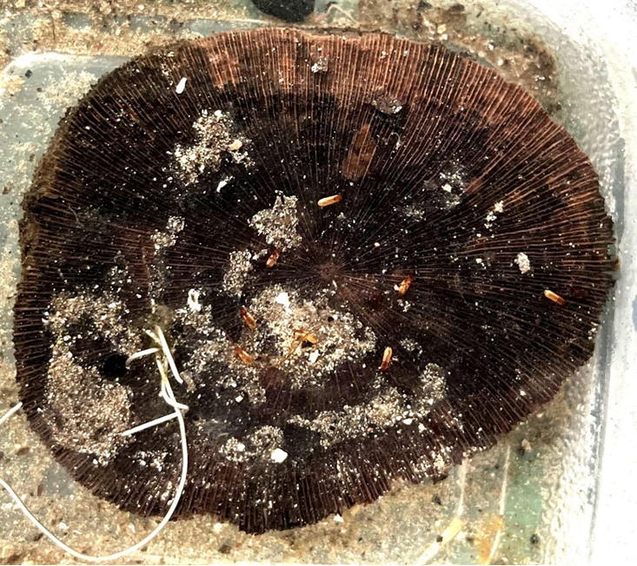
Comal Springs dryopid beetle monitoring protocol
Goal: Develop monitoring protocols for the previously unmonitored Comal Springs dryopid beetle.
Evaluate and standardize the use of wooden discs to capture the animal. Wooden disc have recently been proven as an effective capture technique during Refugia collections.
2026 findings:
Low flows limited areas that could be sampled for much of the year.
Spring Island served as the most useful area to test wooden disc techniques.
Early data suggests CSDB are more common or detectable during February-April.
Field sampling will be complete by end of 2026 with report available in 2027.

Slide 7
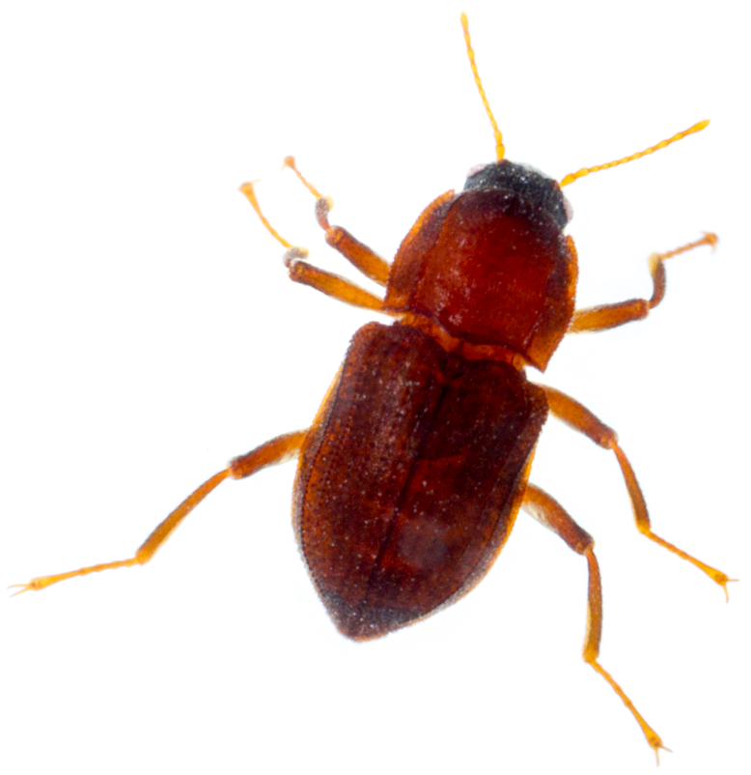
Comal Springs dryopid beetle monitoring protocol
Goal: Examine population genetics of the Comal Springs riffle beetle based on collected specimens from 2007-2024.
Estimate genetic diversity, patterns of gene flow, and population structure for each locality and temporal sample (n=4) and assess change over time.
Estimate effective population sizes at each locality and explore if there is evidence that any populations have gone through a genetic bottleneck.
2026 progress: Individuals of CSRB and CSDB were sent to genome sequencing lab. CSDB extraction was successful and ready for sequencing. CSRB extraction unsuccessful, additional specimens being sent to lab.
Final report planned by end of 2027.

Slide 8
EAHCP Data Management
Goal: Develop a simple, public-facing Shiny-based data portal that allows users to query, filter, and download approved EAHCP environmental monitoring datasets.
Provides access to core EAHCP datasets.
Focused on data discovery and standardized downloads, not analysis, modeling, or interpretation.
Built around a maintainable, configuration-driven framework so EAA can update datasets, metadata, schemas, and download packages annually without rebuilding the application.
Presently, in the data standardization and architecture design phase. Plan to hand off to a developer early 2027.

Slide 9
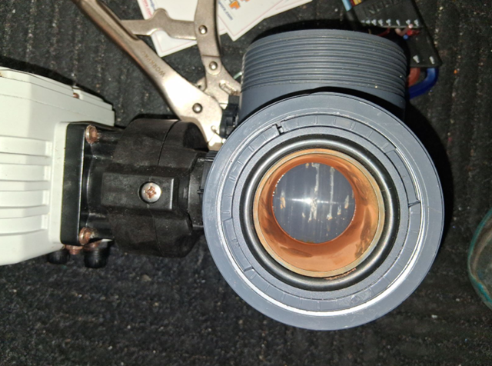
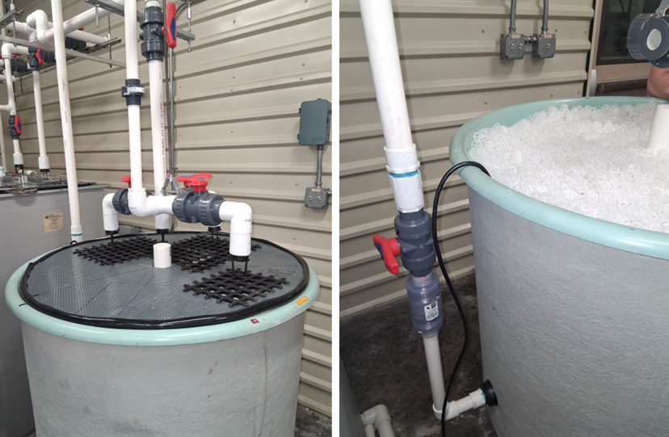
Refugia Program
Gas supersaturation event occurred at the Uvalde hatchery on June 6th resulting in the loss of 231 San Marcos salamanders and 92 Texas blind salamanders.
There was an interruption of power to the well pump and a malfunction of the diversion valve when supersaturated water was detected. A chunk of calcium carbonate was wedged into the valve allowing it to not fully close.
New standard operating procedures have been adopted:
Diversion valve exercised weekly and will be broken down and cleaned or replaced on a bi-annual basis.
Off-gassing chambers installed to reduce saturated gas before entering systems.

Slide 11
HYDROLOGIC UPDATE
Hydrologic conditions set the operating context
Lead with the condition, then connect it directly to implementation.
SPRINGFLOW THROUGH THE IMPLEMENTATION YEAR
Illustrative styling: observed flow, threshold band, and implementation annotation
CONTEXT
Current condition
Replace with the springflow percentile, trend, or operational category most relevant to the meeting.
IMPLEMENTATION RANGE
IMPLEMENTATION LINK
State the specific program implication in one or two sentences.
OBSERVED
THRESHOLD
JAN
DEC
HYDROLOGIC UPDATE
05

Slide 12
PROGRAM STATUS
Program components are best reviewed by purpose and status
This format works for ASR, VISPO, irrigation suspension, regional conservation, or other measures.
COMPONENT
ROLE IN SPRINGFLOW PROTECTION
CURRENT STATUS
Program component A
Describe the mechanism and the operational value it provides.
ON TRACK
Program component B
Describe the mechanism and the operational value it provides.
WATCH
Program component C
Describe the mechanism and the operational value it provides.
ACTIVE
Program component D
Describe the mechanism and the operational value it provides.
COMPLETE
DISCUSSION PROMPT
Where is implementation functioning as designed, and where does the committee need additional evidence or context?
PROGRAM STATUS
06

Slide 13
MAP + EVIDENCE
Place-based evidence keeps the program grounded
Use this layout for wells, service areas, springs, reaches, refugia, or implementation geography.
WHAT THE MAP SHOWS
1
Location-specific finding
One sentence interpreting the first feature or spatial pattern.
2
Implementation connection
One sentence connecting geography to program operations or risk.
3
Point requiring attention
Use coral only for an exception, threshold, or discussion item.
MAP / GIS FIGURE
Replace this placeholder with an exported map. Preserve generous margins and keep legends compact.
SPATIAL EVIDENCE
07

Slide 14
IMPLEMENTATION PATHWAY
Show how evidence becomes implementation
A simple pathway clarifies triggers, responsibilities, and intended outcomes.
OBSERVE
INTERPRET
ACT
EVALUATE
01
02
03
04
Hydrologic signal
Program determination
Implementation action
Outcome and learning
Monitoring, forecasts, and operational conditions.
Apply thresholds, rules, and professional judgment.
Activate, sustain, adjust, or conclude the measure.
Assess hydrologic and biological response.
KEY QUESTION · Is each handoff clear, documented, and supported by the right evidence?
IMPLEMENTATION PATHWAY
08

Slide 15
MONITORING FINDINGS
Pair the condition with the response
Use aligned figures when the comparison—not either figure alone—is the message.
A · HYDROLOGIC CONDITION
B · PROGRAM RESPONSE
Examples: springflow, index well, pumping, recharge, or climate signal.
Examples: volume conserved, action timing, participation, or biological indicator.
COMPARE
MEASURE
MEASURE
TIME / SITE / CATEGORY
TIME / SITE / CATEGORY
MONITORING FINDINGS
09

Slide 16
DISCUSSION / DECISION
What should the committee discuss?
Use this slide to convert information into focused scientific dialogue.
01
Is the evidence sufficient?
Identify gaps in monitoring, interpretation, or communication.
02
Is implementation performing as intended?
Separate operational execution from environmental outcome.
03
What should change before the next cycle?
Name a specific analysis, action, or decision owner.
COMMITTEE DISCUSSION
10

Slide 17
EAHCP · SPRINGFLOW PROTECTION
Questions and
discussion
Appendix slides may follow using the same figure and status layouts.
PRESENTER · TITLE · CONTACT
Edwards Aquifer Habitat Conservation Plan

